Slide 1
How to use ADI systems
GAMI - Confidential مقيد

Slide 2
Welcome to ADI services
Email Services at Google Workspace
You need first to visit https://adi.edu.sa/st
Then you need to use your National ID
After search your email and password information will appear

Slide 3
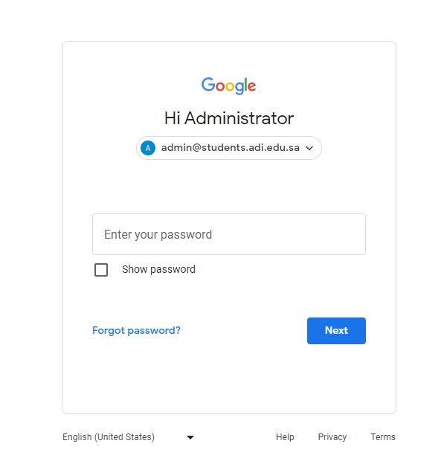
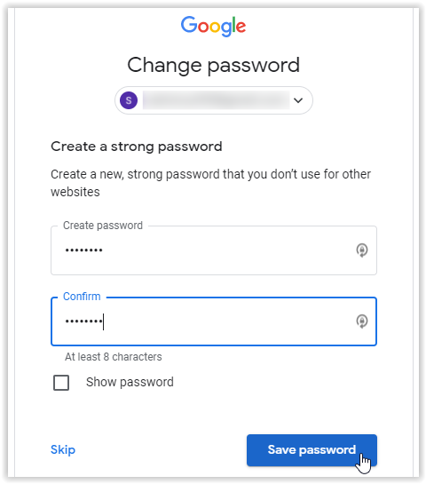
Login with your Academy email and password
System will required to change your password, make it strong password with symbols like @#$% then click Save password
First go to www.gmail.com
Write your username and password
Now your logged in you can use all google features like drive / class / meet and others

Slide 4
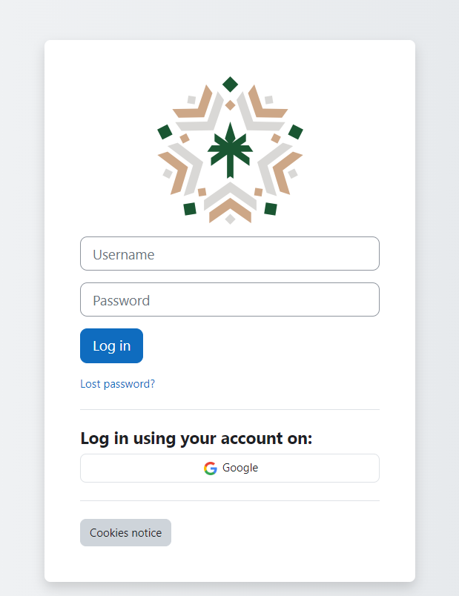
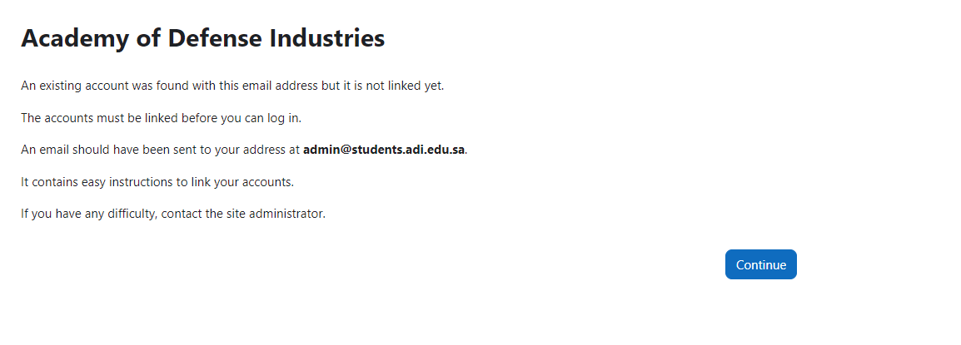
For learning management system LMS
1- Go to lms.adi.edu.sa
2- Login Using your account then click continue

Slide 5
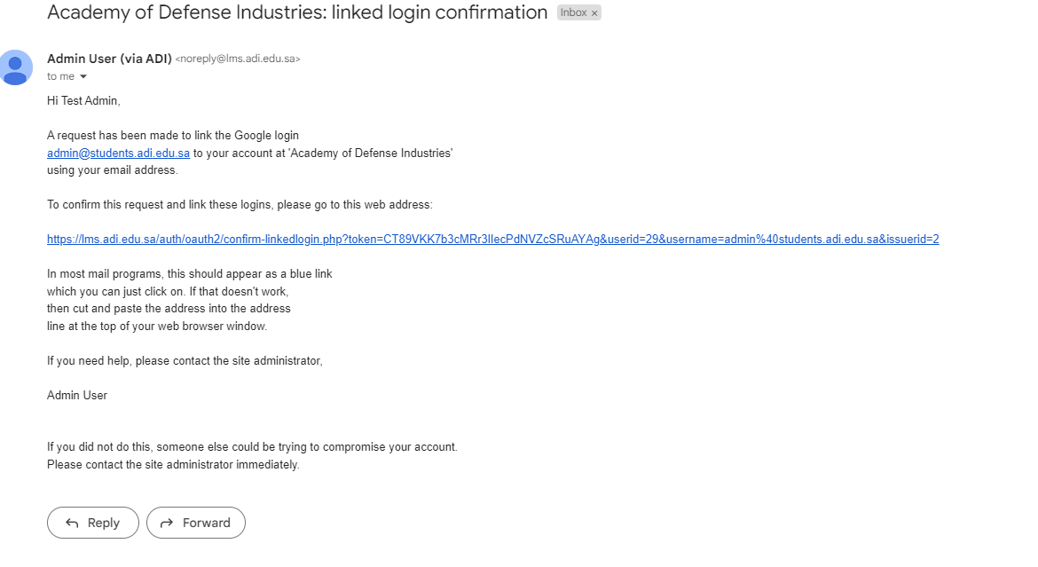
For learning management system LMS
3- Back to your email and click on the link to active your account at LMS
4- Now click login and use again google login button

Slide 6
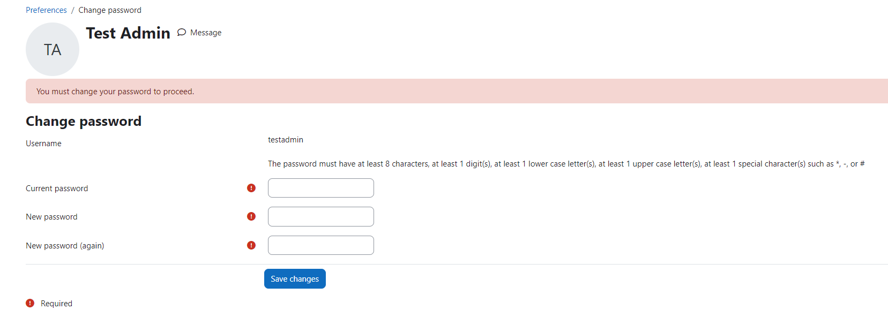
For learning management system LMS
Now change your password and click on save changes

Slide 7
For learning management system LMS
Now you are in, you can view your courses

Slide 8
For learning management system LMS
You can download your Mobile app
Or you can go to your store and search for Moodle
Then search for lms.adi.edu.sa and login using your Google account via the button below

Slide 9
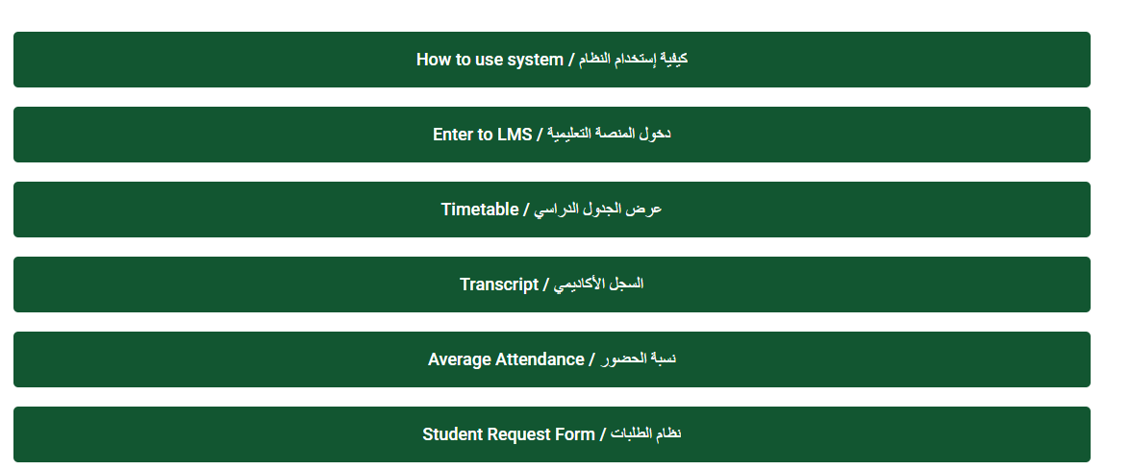
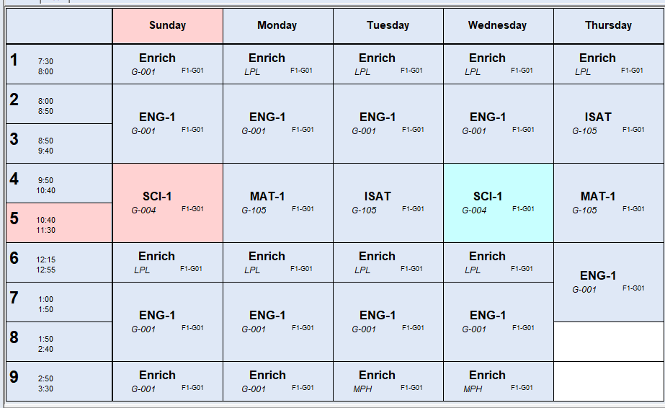
For Timetable and other services
You need first to visit https://adi.edu.sa/st Then you go to timetable and check your group from the data you got

Slide 10
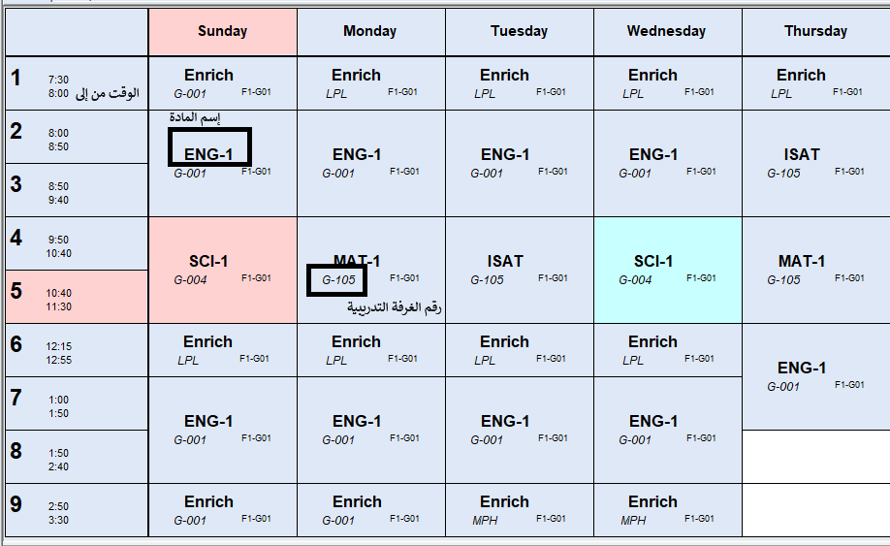
For Timetable and other services
How to read timetable

Slide 11
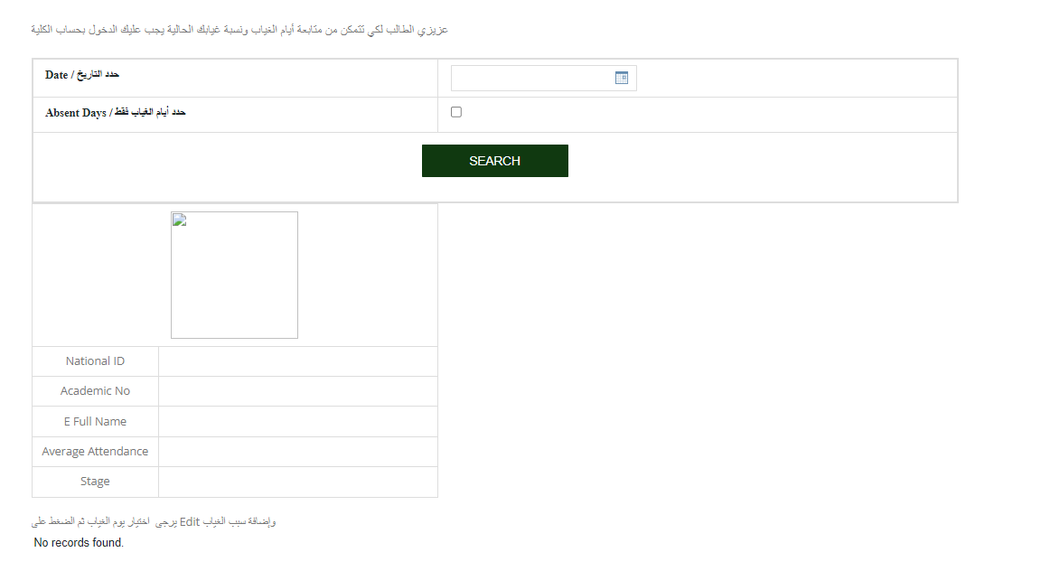
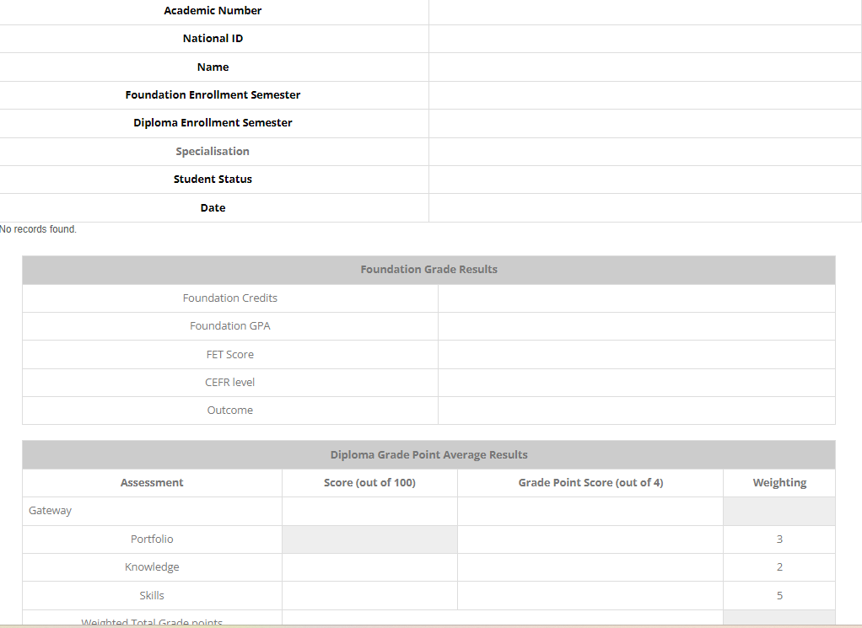
For other services like attendance / transcript and others you will need to login using your email and the data will appear for your record

Slide 12
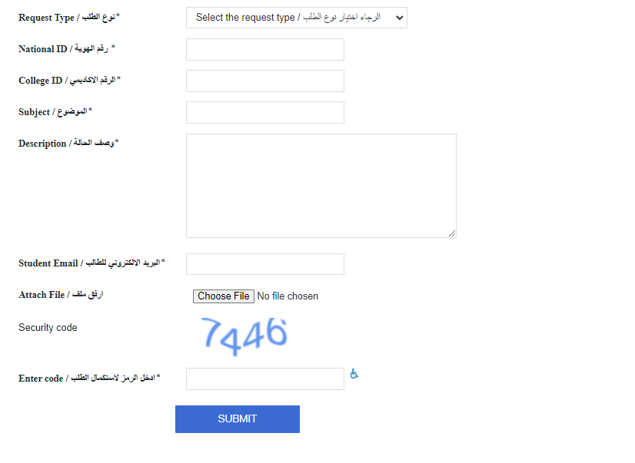
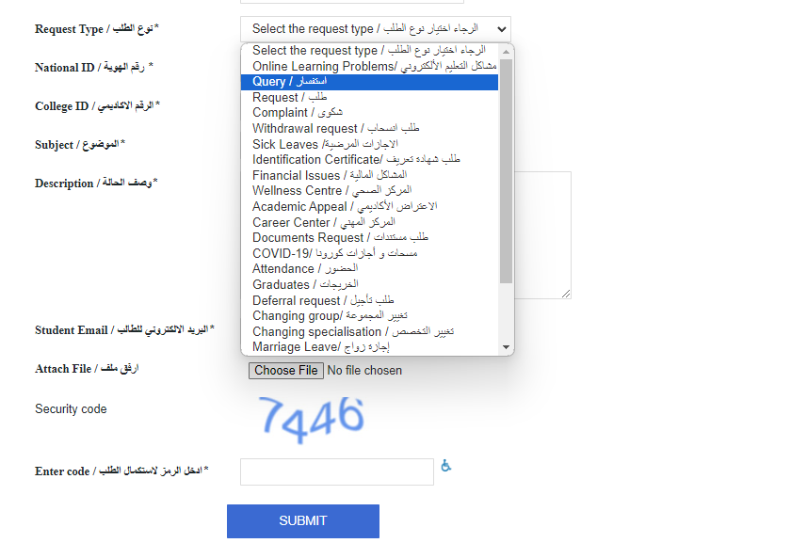
For ticketing system you need to login with your email to the students request form and apply your request

Slide 13
Incase you have any difficulties please contact with Students Services team at ss@students.adi.edu.sa
Thank you
ADI Team

